Slide 1
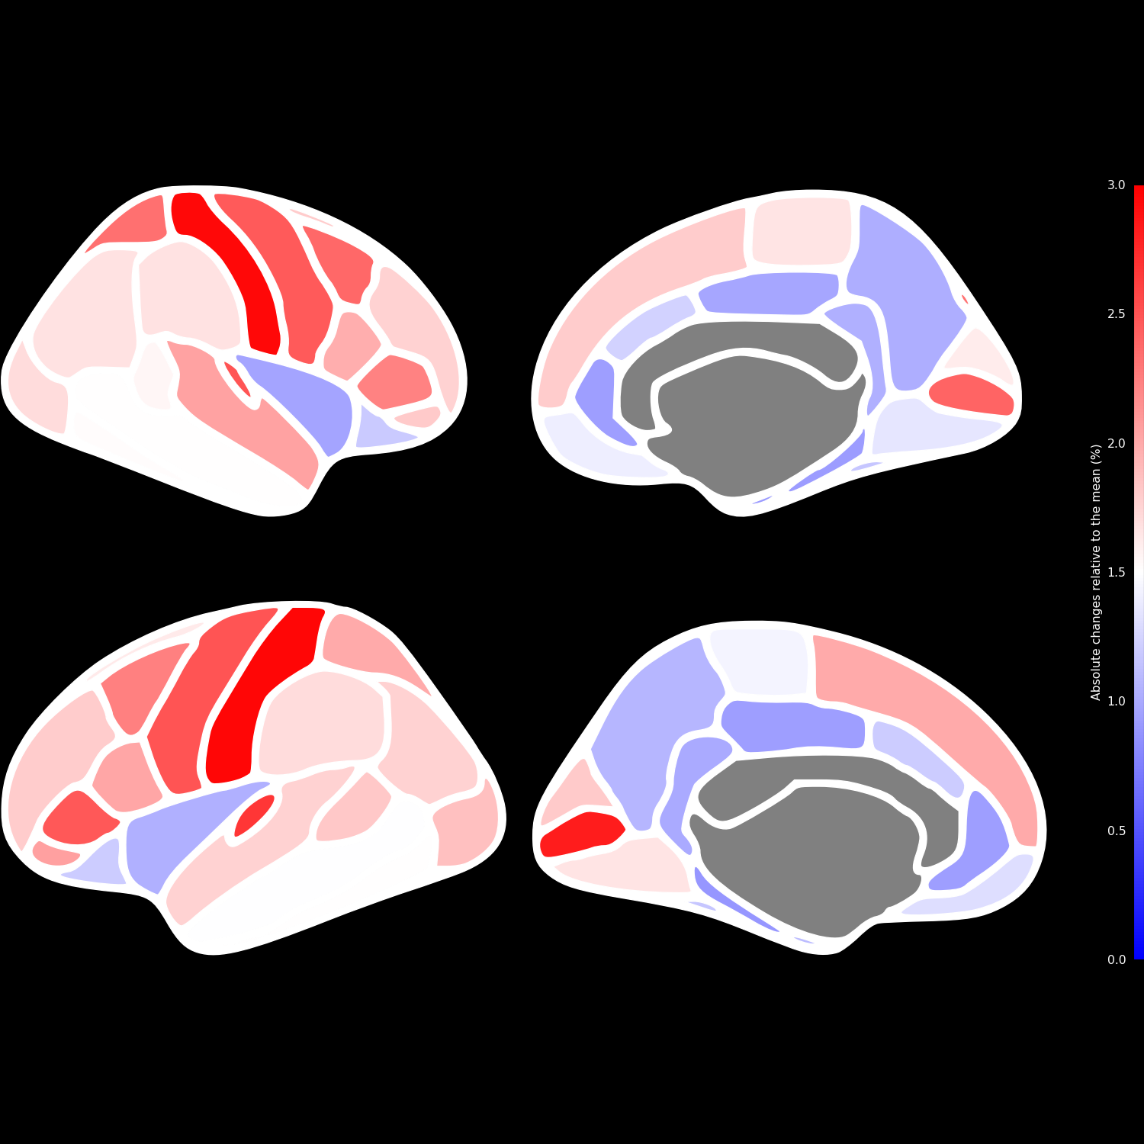
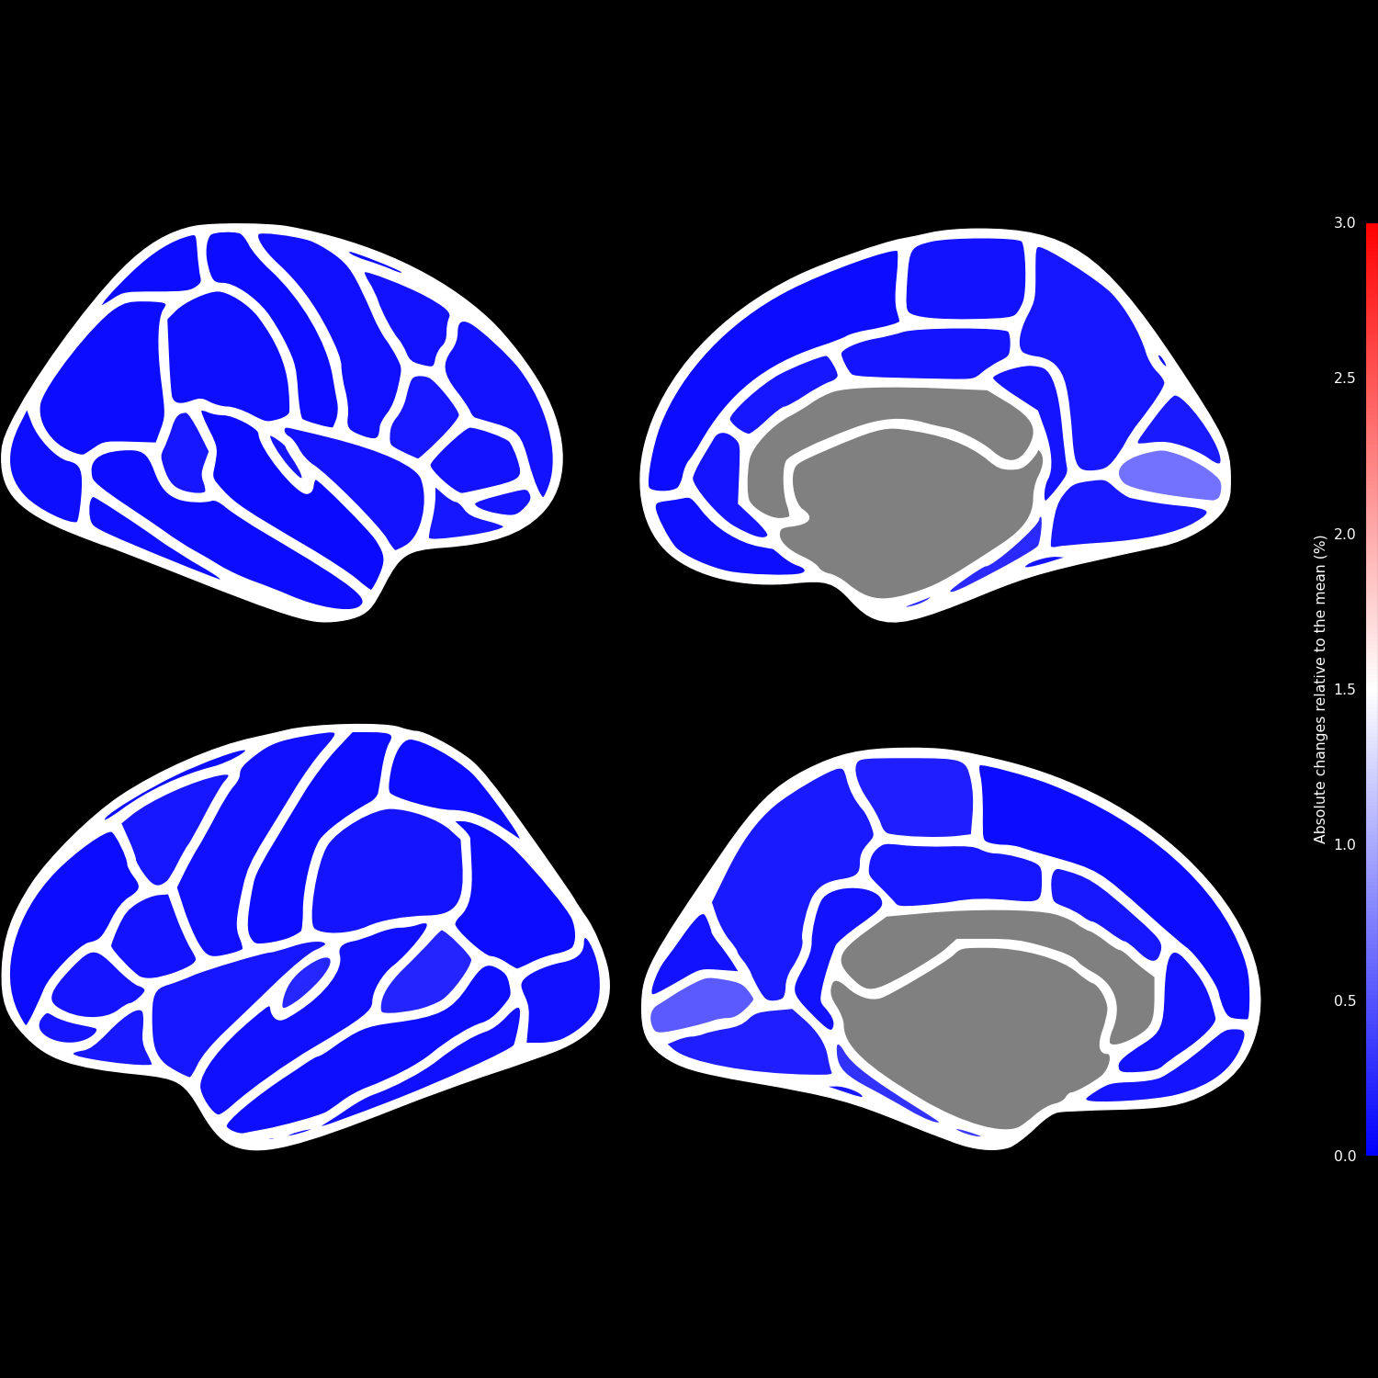
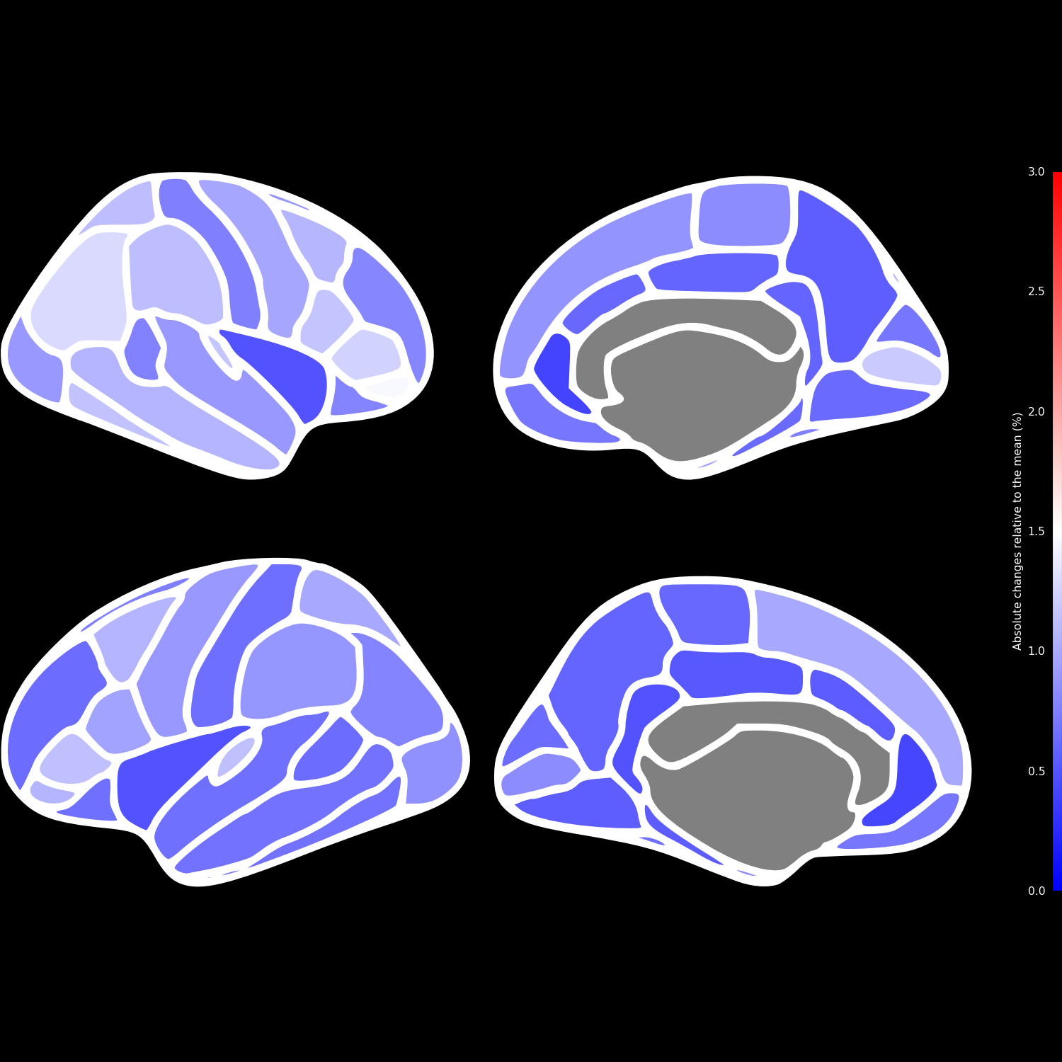
Left lateral
Left medial
Right lateral
Right medial
ANTs
ANTsPyNet
DL+DiReCT

Slide 2
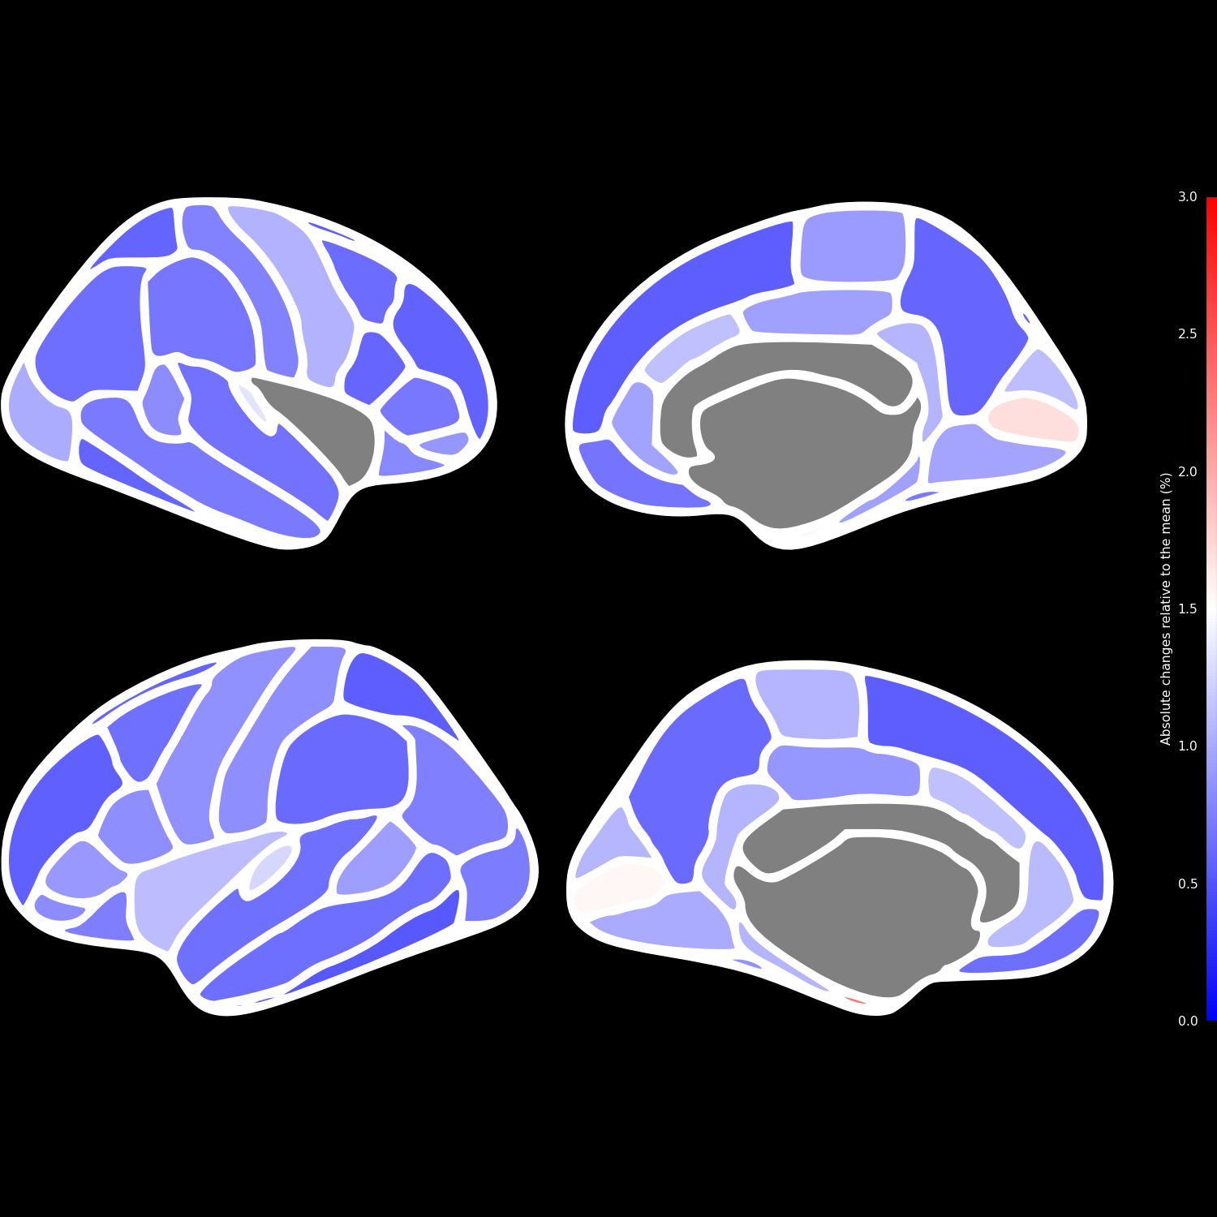
Left lateral
Left medial
Right lateral
Right medial
ANTs
ANTsPyNet
Freesurfer
DL+DiReCT

Slide 3
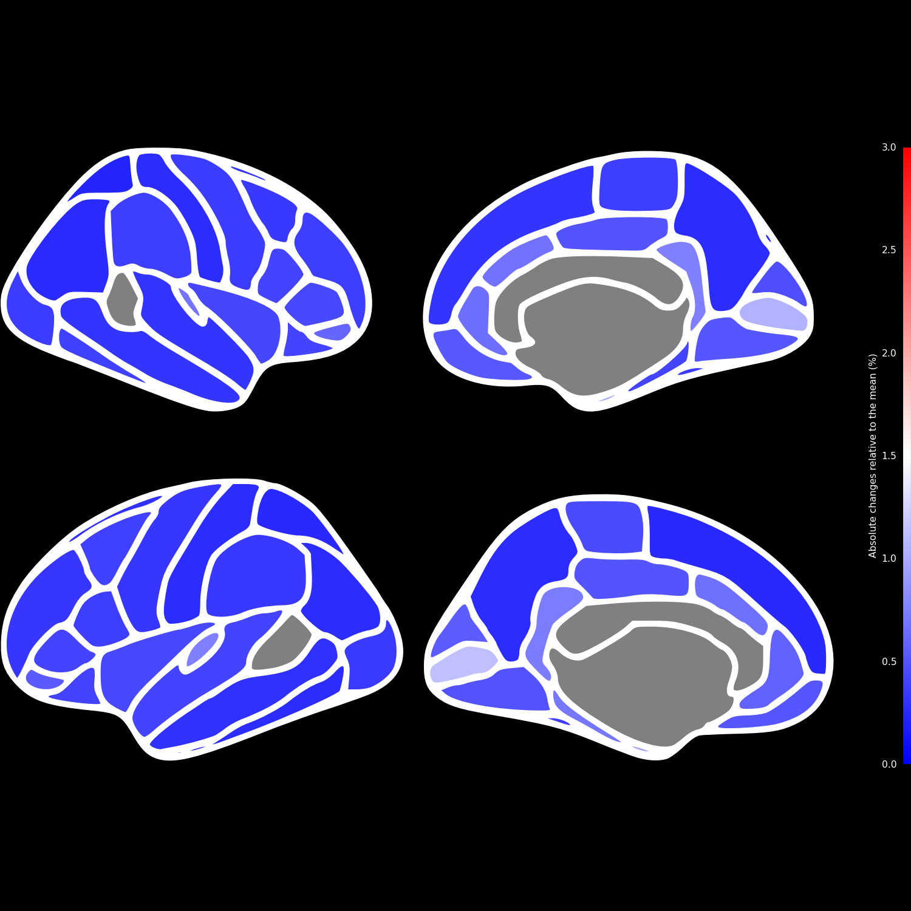
Left lateral
Left medial
Right lateral
Right medial
ANTs
ANTsPyNet
Freesurfer
Fastsurfer
DL+DiReCT

